Slide 1
Presentation for Interested Organizations

Slide 2
The Georgia Foundation for Agriculture has partnered with various commodity groups and Georgia Farm Bureau, Georgia's largest voluntary agricultural organization with nearly 300,000 member, to bring the Georgia Ag. Experience to students across the state.
Why should you expose your students to agriculture?
It is Georgia’s #1 industry employing 1 in 7 Georgians.
In order to ensure that agriculture continues to be the leading industry in our state, we need students who are employed in agriculture and who advocate for agriculture.
The Need For A Mobile Agriculture Classroom

Slide 3
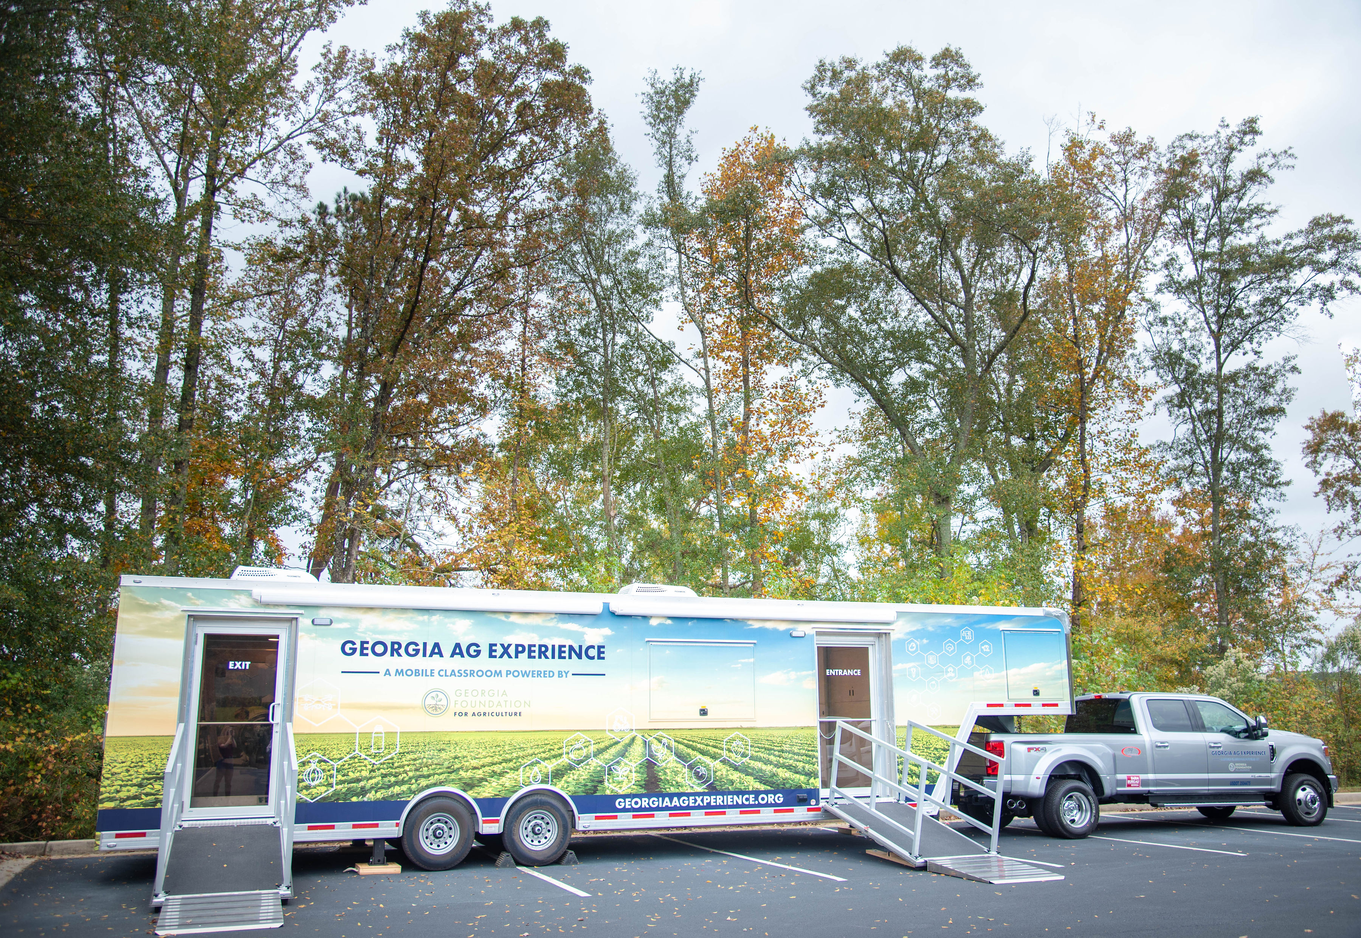
Bring Georgia agriculture to your school!

Slide 4
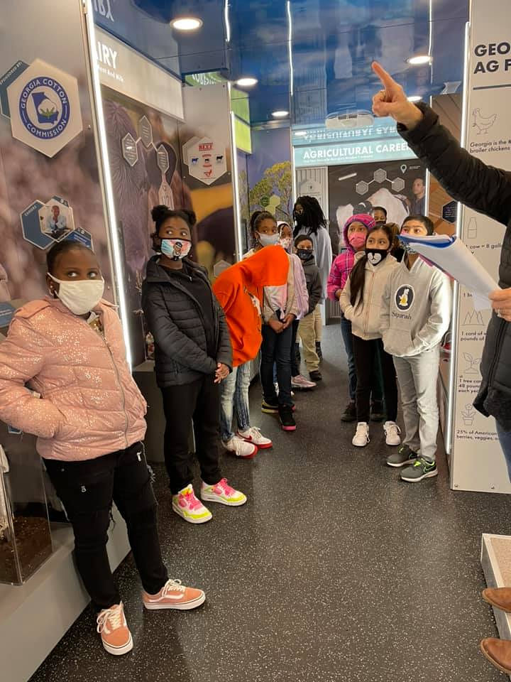
Why we love our program!
Mobile classroom comes directly to your organization!
Agriculture is no longer a thing of the past! This mobile classroom is high-tech and shows the future of farming!
Targeted at grades 3-5 but welcome to all ages!
The curriculum was developed by UGA Ag Education and Leadership Professors
There is a strong emphasis on careers and STEM.
Our Agricultural Careers Interest Survey for the careers station was approved by the Georgia Department of Agriculture and Georgia Agricultural Education

Slide 5
What is the “Georgia Ag Experience”?
The Georgia Ag Experience is a unique STEM based educational program that invites students across Georgia to explore the vast opportunities in agriculture.
Grades: 3 -5 The full education program involved 3 main components:
1
2
3
PRE VISIT
VISIT
POST VISIT
Previsit tasks to prepare you for your visit!
1-hr in person experience per student with self guided study or an open house event for larger crwod
Surveys for feedbacl to better the experience!

Slide 6
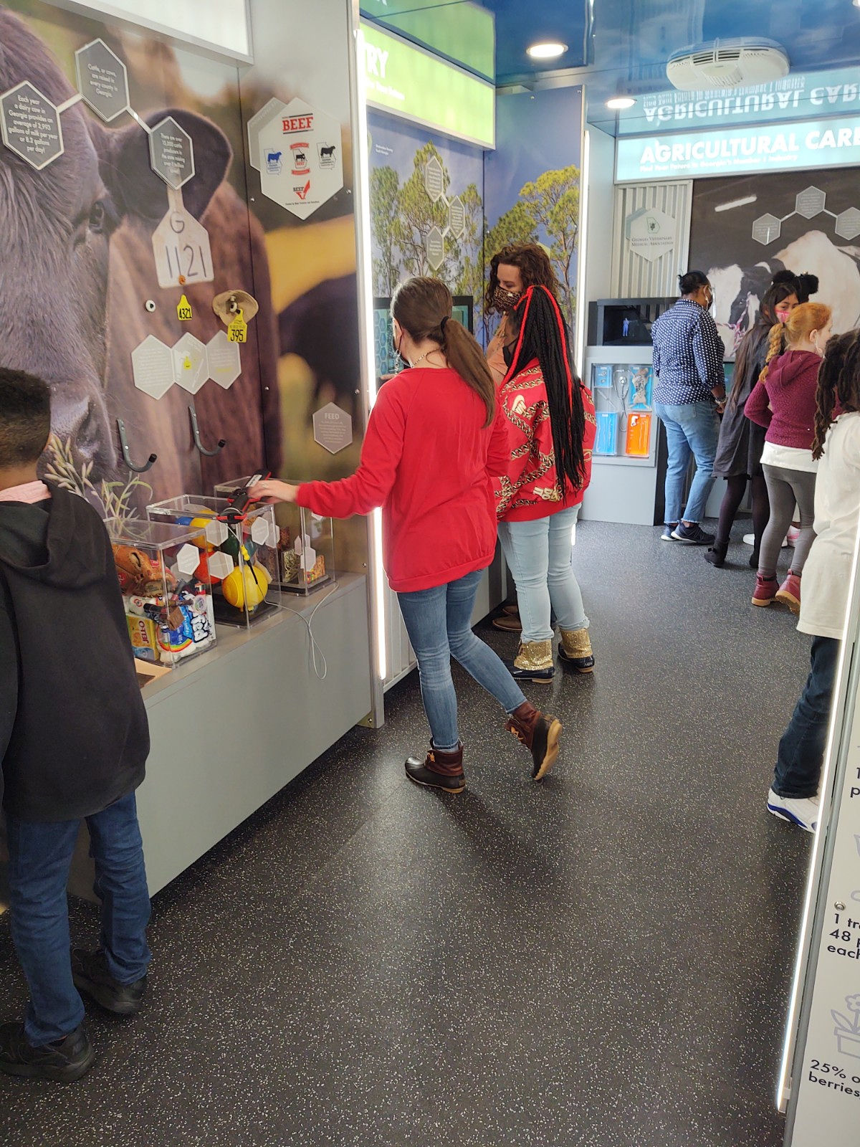
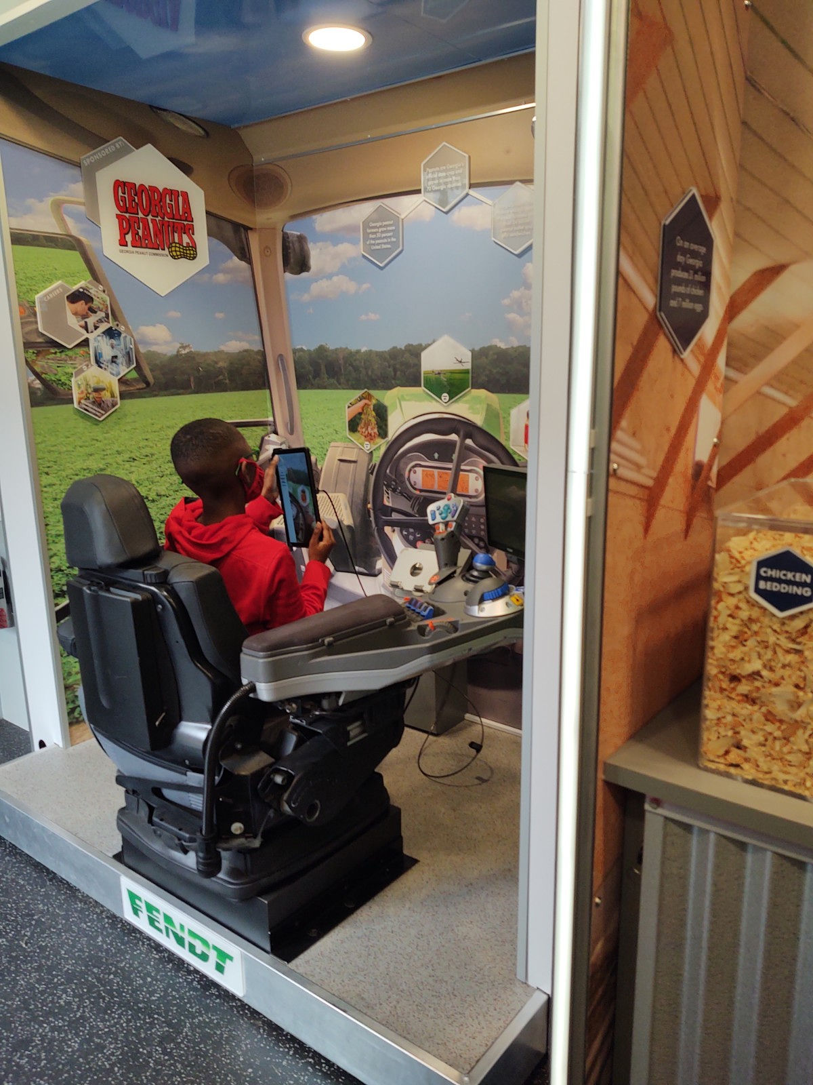
GET READY FOR SOME EXCITING AG-TIVITIES!

Slide 7
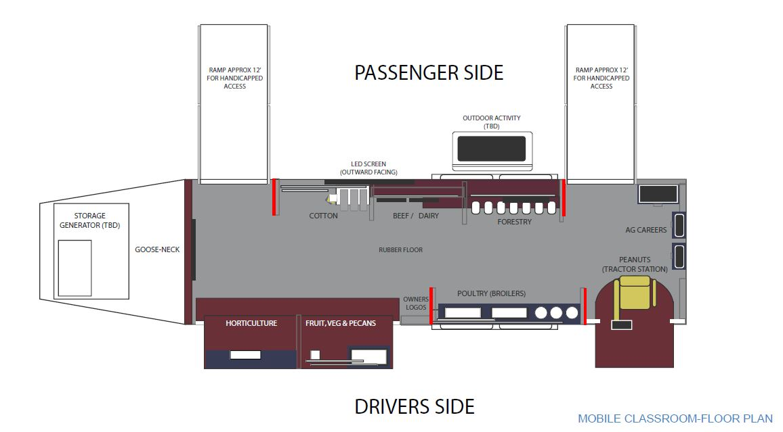
Educational Program Assistant will welcome people in & explain the trailer!
Activities can be conducted outside with local farm bureau!
Inside the mobile classroom: floorplan

Slide 8
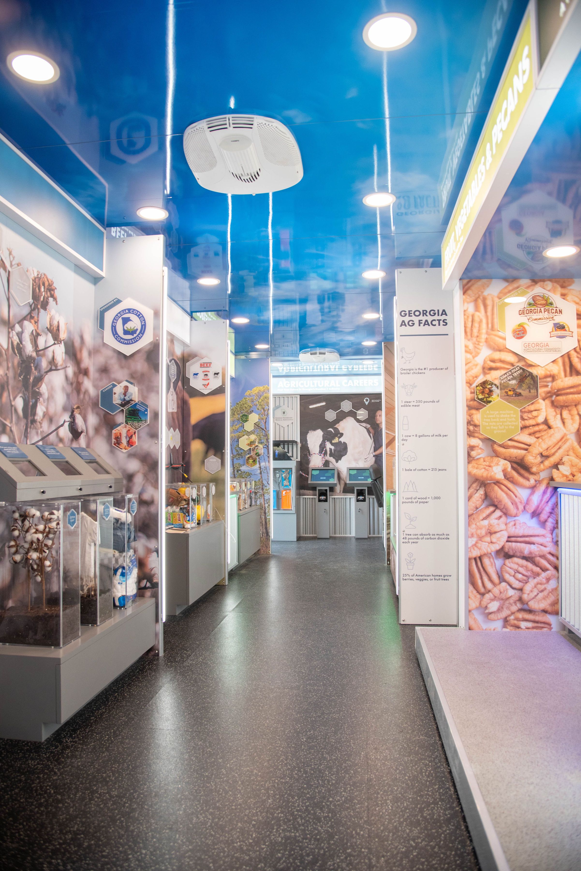
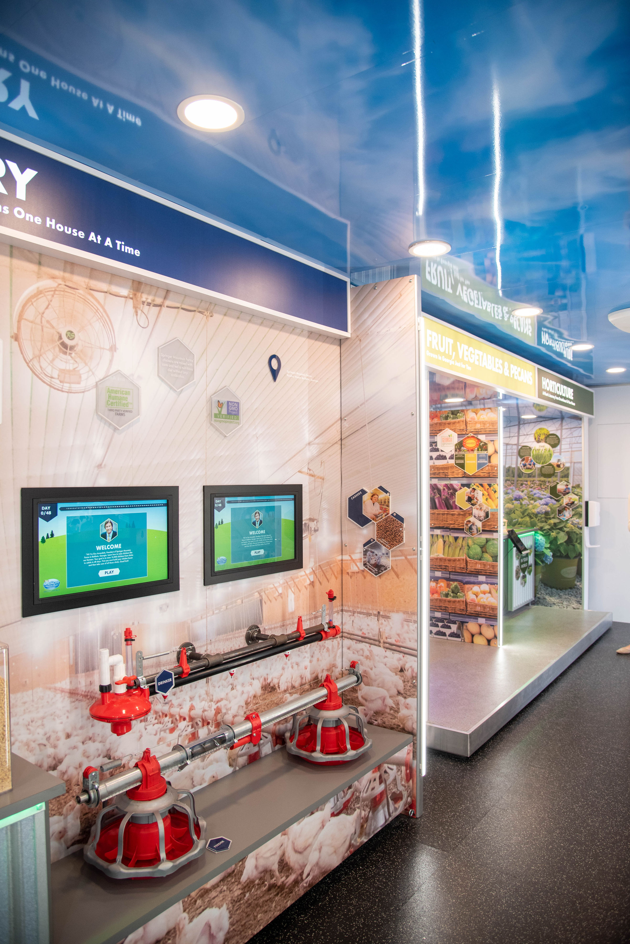
Mobile Classroom Visit:
Structure:
Depending on your event, we can accommodate to your needs!
Open House Style
Visitors walk through at their own pace and Educational Program Assistants & Volunteers help with questions and directions on games!
Fair Style
The mobile classroom is one of multiple stations & visitors rotate to each station!
Full Educational Program- Explained on slide 5.
OUTSIDE
INSIDE
Live “Ag-tivity”

Slide 9
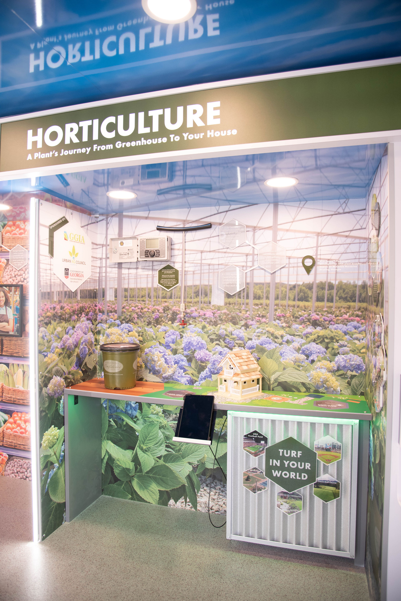
Summary: The diversity of the horticulture industry is shown through interactive augmented reality scenes that tell the journey of a plant from greenhouse to garden center to right in your backyard
Technology Used: Tablet on a slider that moves across three augmented reality animations:
Lessons Learned:
3D growing flower with labeled plant parts to learn the anatomy of a plant
Right Plant Right Place - Describe your backyard to pick the perfect plant for the right conditions
Is the soil wet or dry?
Is it sunny or shady?
Do you have a lot of space or a little bit of space?
Design your backyard - Build the yard by selecting the right plant from options and planting it in the correct location in your yard
Sponsors: Georgia Green Industry Association, McCorkle Nurseries, UGA Research Foundation, Urban Ag Council

Slide 10
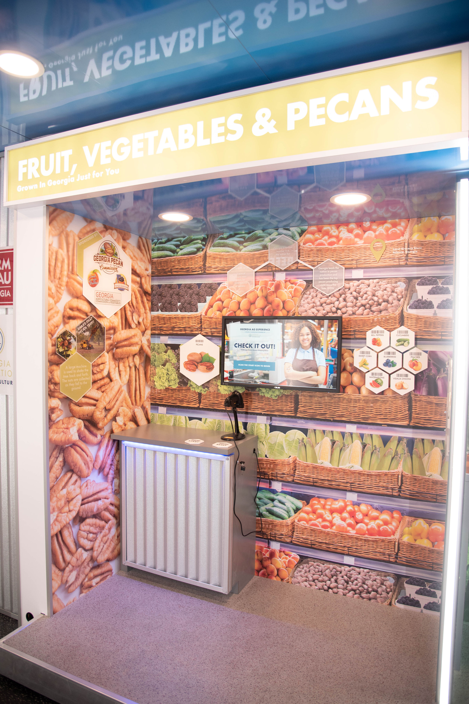
Summary: Students act as a grocery store clerk and learn how to recognize Georgia grown food products with a UPC scanner learning activity
Technology Used: UPC Scan Gun and Checkout Video Game
Lessons Learned: Students learn fun facts about Georgia grown products include: pecans, peaches, blueberries, cucumbers, bell peppers, corn, watermelon and onions
Sponsors: Agricultural Commodity Commission for Vegetables, ACC for Pecans, Georgia Peach Commission, Georgia Blueberry Commission

Slide 11
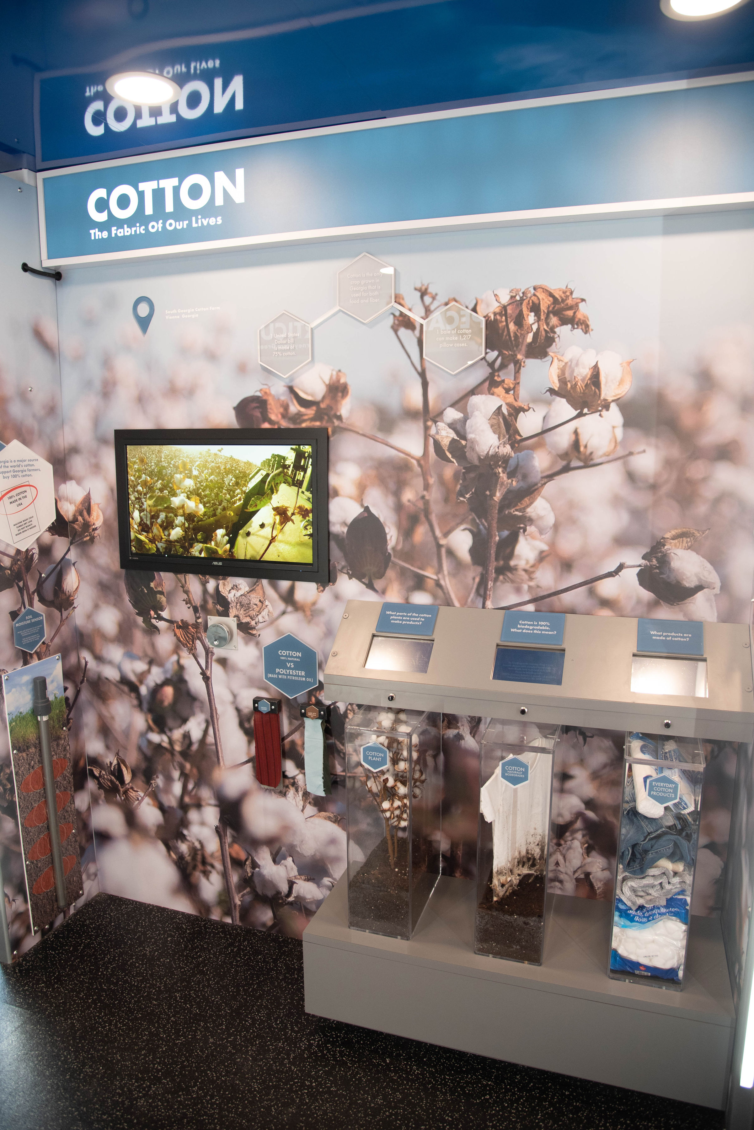
Summary: Students explore the cycles of cotton production with a video spinner that allows the scenes to be played in reverse, sped up or slowed down. Cotton materials are compared side by side to petroleum-based products.
Technology Used: Video Spinner. Turn a dial to play the video in reverse, fast forward, etc.
Lesson Learned: Cotton vs. polyester, byproducts of cotton, how cotton is grown, harvested and produced.
Sponsors: Georgia Cotton Commission

Slide 12
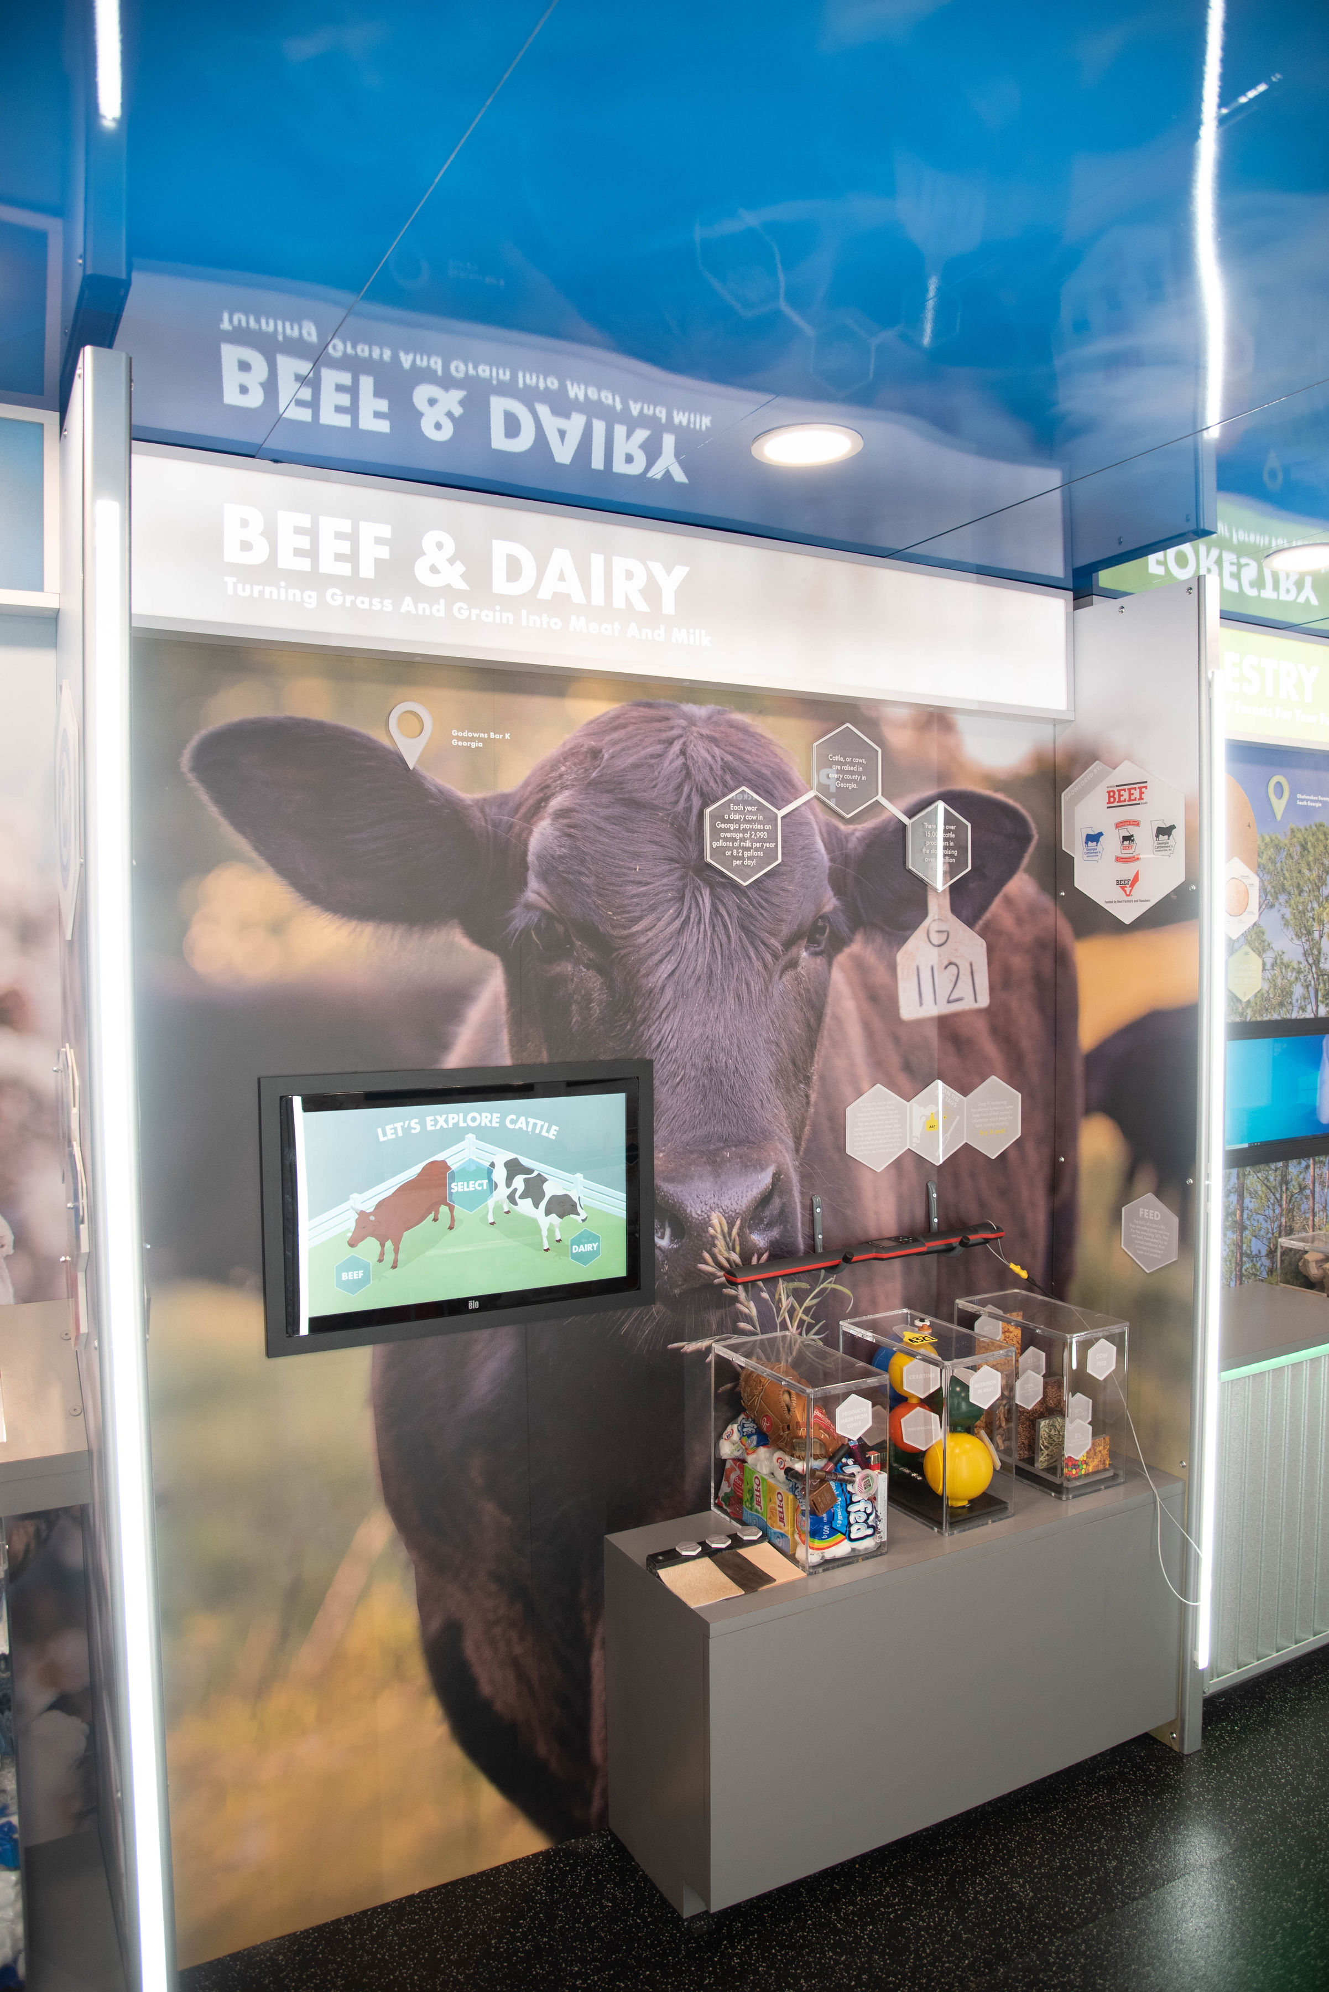
Summary: An animated learning game where students experience the job responsibilities of typical industry careers and get the option of exploring both beef and dairy industries.
Technology Used: Video Game with Touchscreen
Lessons Learned: Careers in the beef and dairy industry, how an animal is raised, what they are fed and what they become
Sponsors: Agricultural Commodity Commission for Beef, Georgia Cattlemen's Association, Georgia Cattlemen’s Foundation, Georgia Beef Board

Slide 13
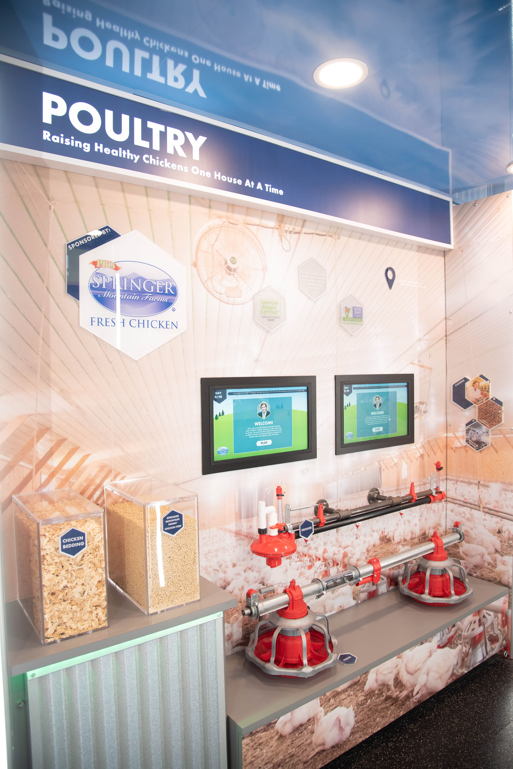
Summary: A comprehensive learning game experience where students engineer a poultry house and must successfully raise hundreds of chickens
Technology Used: Video Game with Touchscreen
Lessons Learned: How to engineer a poultry house, how chickens are raised and cared for, and what they are fed
Sponsors: Fieldale Farms (Springer Mountain)

Slide 14
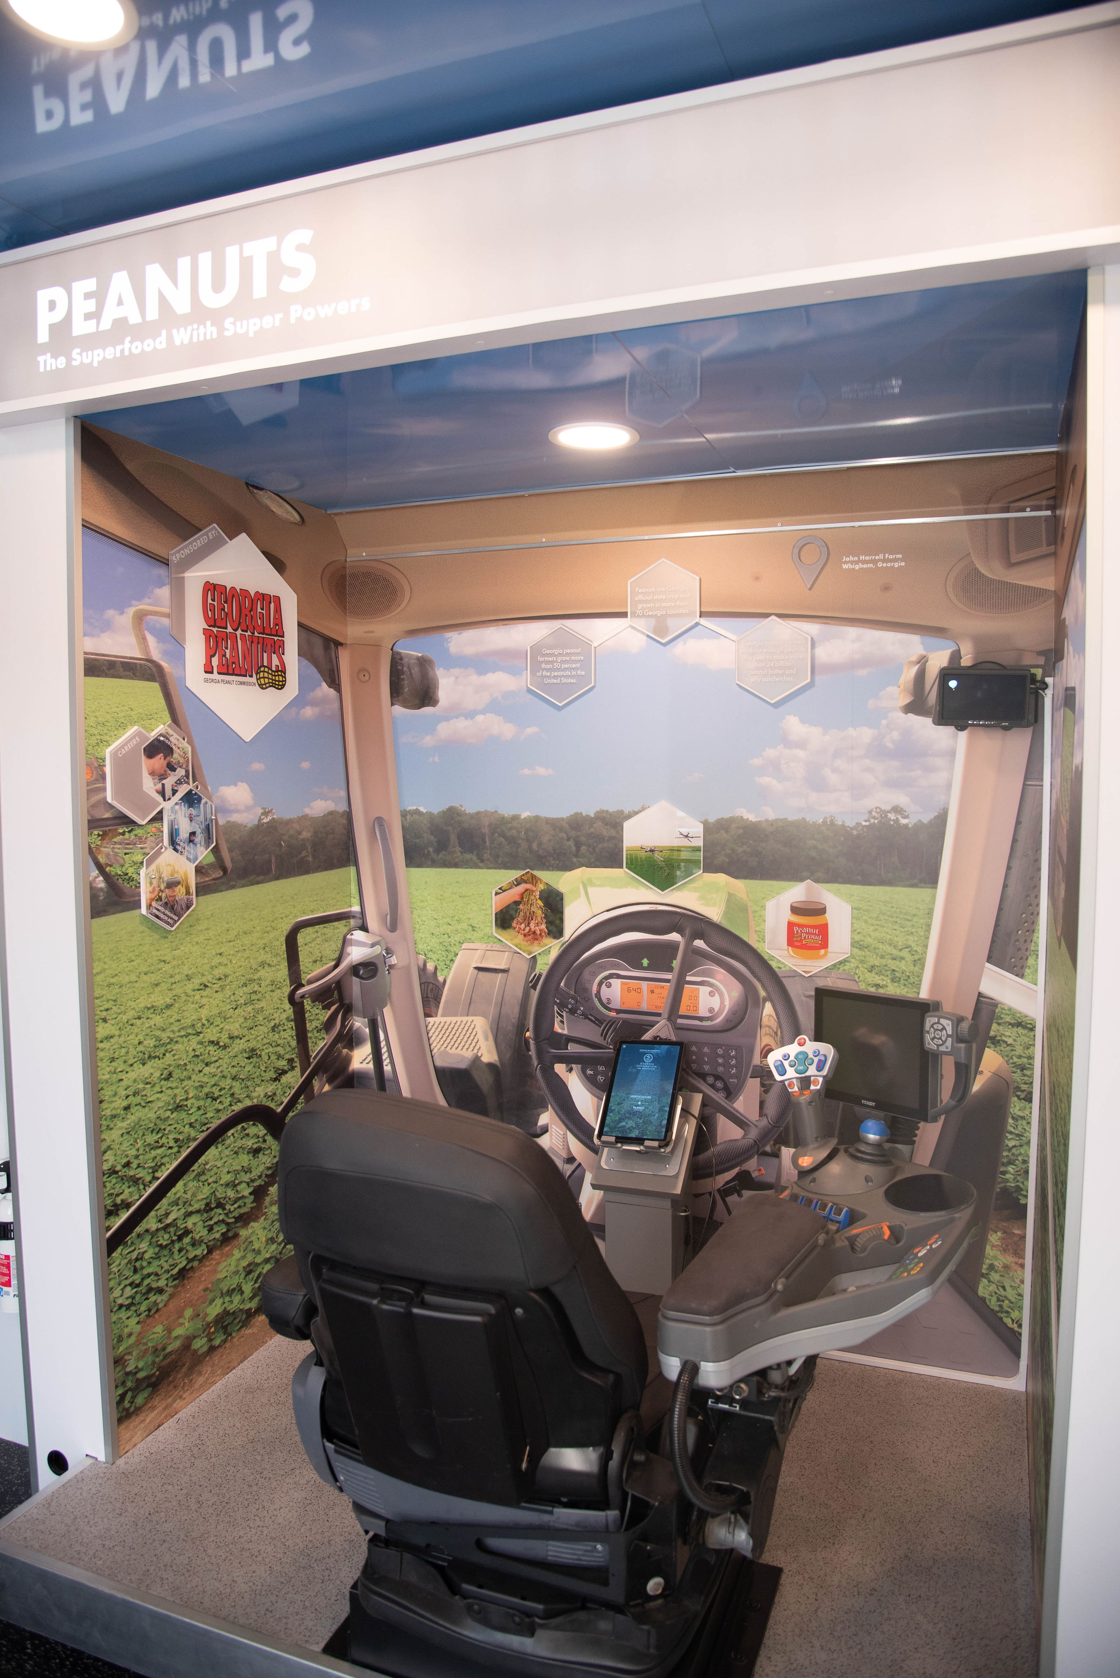
Summary: An augmented reality FENDT tractor simulator that allows students to experience the peanut planting, harvesting and post-harvest production
Technology Used: Tablet on a pull cord - when an image is scanned it takes you through three scenes..
Lesson Learned:
Planting season for peanuts & learned the anatomy of a peanut plant. Facts about how much water they need and how long they take to grow
Harvesting Process - Drone animation shows the tractor “digger” in the soil with the remaining peanut pods; the tractor combine removes the vines from the peanuts
Finished Product - what happens after the peanuts leave the field? How does the peanut get processed to make peanut butter?
Sponsors: Georgia Peanut Commission & FENDT Tractor/AgCo

Slide 15
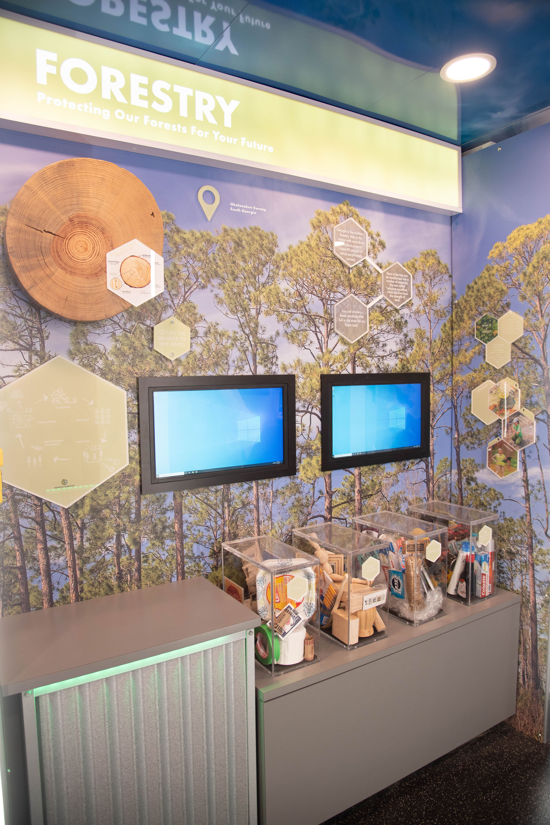
Summary: With a byproducts matching learning activity, students learn the surprising outputs that come from trees
Technology Used: Touchscreen video game
Lessons Learned: The byproducts of trees

Slide 16
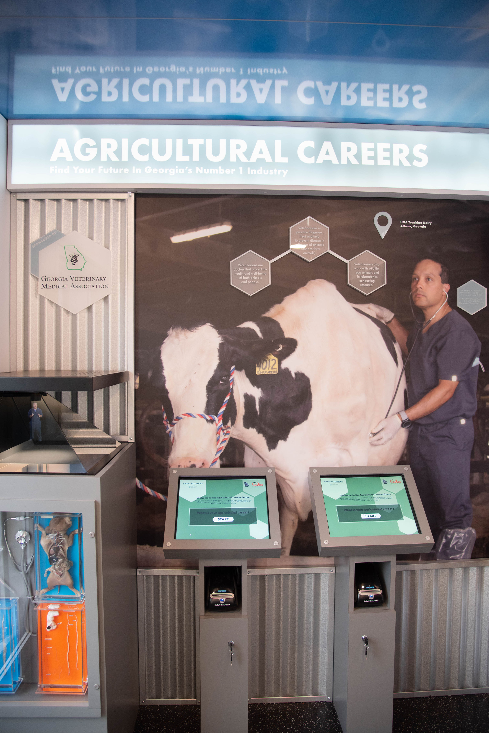
Summary: Student explore the vast opportunities in agriculture by taking a career interest survey. They receive their results with a career badge sticker and watch interactive hologram videos to learn from ag professionals
Technology Used: Career Interest Survey on touchscreens + hologram of agricultural careers
Themes: Careers in Agriculture + Large Animal Veterinarians
Sponsors: Georgia Veterinary Medicine Association

Slide 17
Cost:
Mobile Visit Fee
County Office
Organizations Budget
4 ways to pay
Local Sponsors
Combination
1
2
$250
3
per day
4
Notes:
Estimated to cost us around $100 per day

Slide 18
Timeline: From Request to Post Visit
Notes:
This is what every visit will look like..
Visits must be requested by the county office- During sign up period - for each quarter
You will be notified at the end of sign up period, and given next steps
There are some forms that are collected prior.
School prep - lesson plan starts 1 week out
Visit days are likely anywhere from 2-5 day.
After the visit, the school participate in lesson and send in surveys

Slide 19
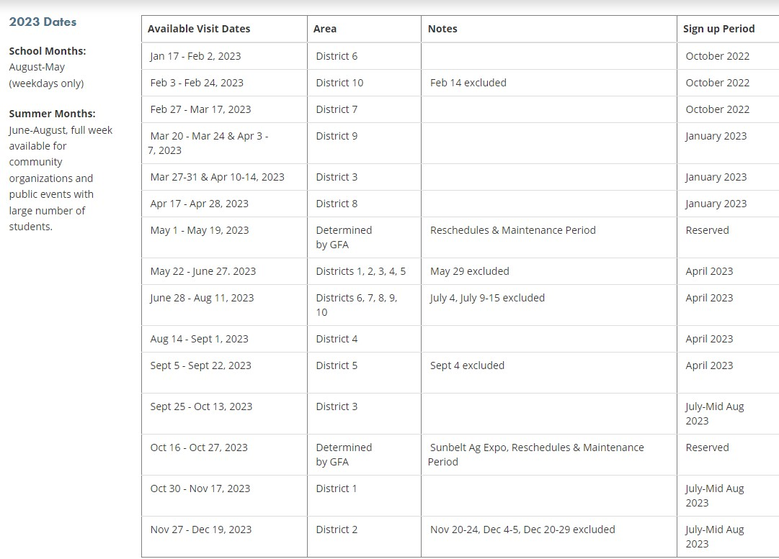
Visit & Sign Up Dates by District
Available Dates for 2023

Slide 20
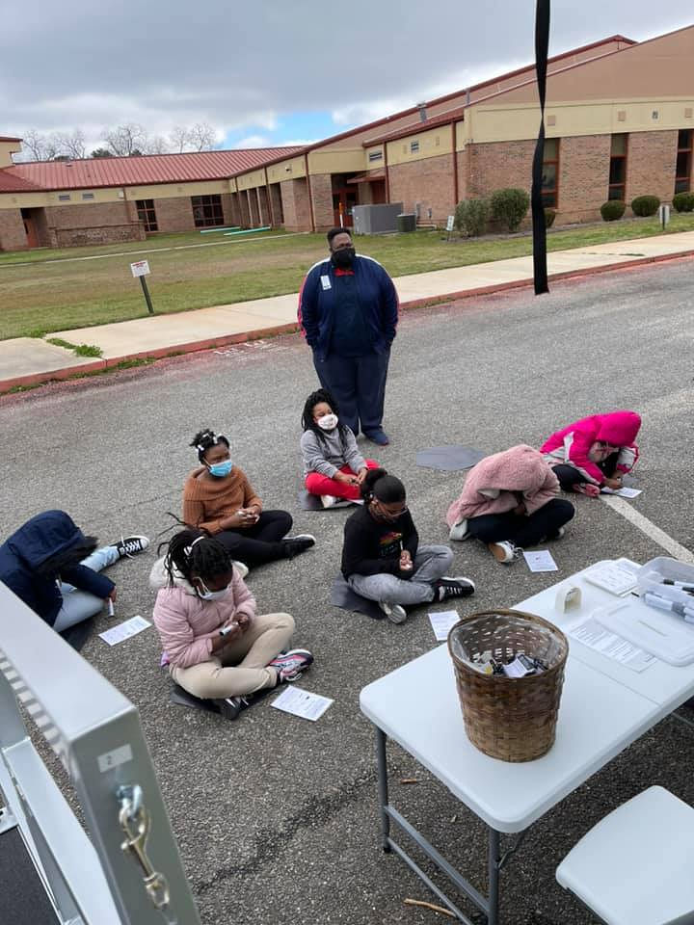
THE KIDS LOVE BINGO!!
Each game lasts 16 minutes.
Students compete for prizes while learning about Agricultural Careers in Georgia!

Slide 21
Boots on the ground! Staffing the classroom
Hauler
Main responsibilities: school communication, delivering the vehicle with full generator gas and managing repairs
Educational Program Assistant
Main responsibilities: ensuring all station and activities are run smoothly, coordinating with organization
Main Contact: County Office Manager (preferred) or designated volunteer
Main responsibilities: Requesting the visit, securing 2 volunteers,, day-of student safety and sanitation, promotion of GAE in community
Support: 1-2 volunteers
Main responsibilities: Day-of student safety and sanitation
Main Contact: 1 organization appointed volunteer
Main responsibilities: educational program assistant communication - developing community schedules, ensuring event is marketed and communication with hauler for delivery
Notes:
We all have a part to play in staffing teh mobile classroom

Slide 22
What’s required?
Organization Provides
Minimum of 100 visitors for the mobile classroom
At least 1 organization appointed volunteer to assist with scheduling & event marketing
Secure, Level, Paved Parking, away from roadways
45’L x 30’W space for trailer (Possible 65’L x 30’W for truck and trailer)
Mobile Classroom Provides:
1 Educational Program Assistant
1-2 Georgia Farm Bureau county volunteers
8 internal stations and external hands-on activity
STEM curriculum developed by UGA
Additional lesson plans for continued engagement
Sanitation and social distancing plans for COVID-19

Slide 23
Additional Resources for Ag Education
Most importantly, we want agriculture to continue to be a staple in your classrooms. Check out
these ideas on how you can do that!
Reserve a “Traveling Trunk” through our County Farm Bureau office. Georgia Farm Bureau has traveling ag education boxes on forestry and peanuts. These kits provide you all the materials you need to teach a lesson (or two) on either topic.
Visit the Georgia Ag Experience website (www.GeorgiaAgExperience.Org). We have fun activities for kids and additional lesson plans that correspond with each station the students visited in the mobile classroom.
Visit gfb.ag/aitc for AgMags, lesson ideas, ag-tivities, no-bake recipes, book suggestions and much more!
Contact us at the local County Farm Bureau office to learn how we can be a part of your classroom lessons and activities.

Slide 24
Thank you!
We appreciate you allowing us to educate your students about agriculture, and please let me know how
we can continue to support agriculture education in your organization.

