Slide 1

Presentation for Interested Schools

Slide 2
The Georgia Foundation for Agriculture has partnered with various commodity groups and Georgia Farm Bureau, Georgia's largest voluntary agricultural organization with nearly 300,000 member, to bring the Georgia Ag. Experience to students across the state.
Why should you expose your students to agriculture?
It is Georgia’s #1 industry employing 1 in 7 Georgians.
In order to ensure that agriculture continues to be the leading industry in our state, we need students who are employed in agriculture and who advocate for agriculture.
The Need For A Mobile Agriculture Classroom

Slide 3
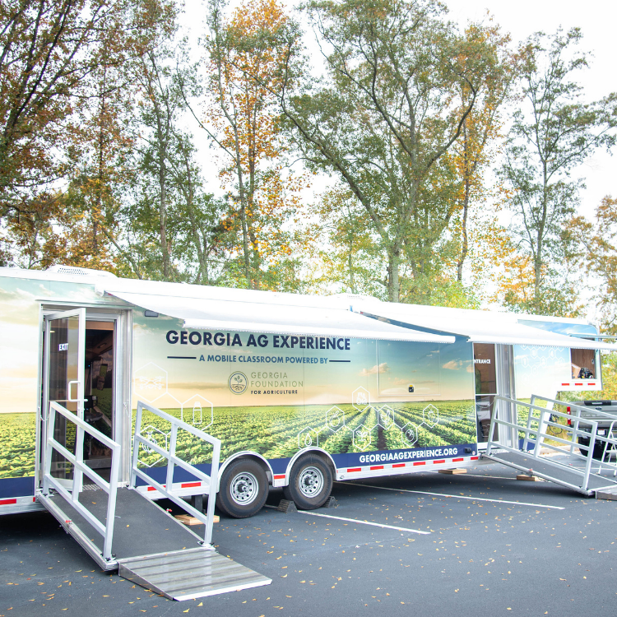
Bring Georgia agriculture to your school!

Slide 4
Why we love our program!
Mobile classroom comes directly to the school!
Agriculture is no longer a thing of the past! This mobile classroom is high-tech and shows the future of farming.
Targeted at grades 3rd-5th
The curriculum was developed by UGA Ag Education and Leadership Professors
The Pre and Post lesson plans provide students with a comprehensive deep-dive into Georgia agriculture
There is a strong emphasis on careers and STEM.
Our Agricultural Careers Interest Survey was approved by the Georgia Department of Agriculture and Georgia Agricultural Education

Slide 5
What is the “Georgia Ag Experience”?
The Georgia Ag Experience is a unique STEM based educational program that invites students across Georgia to explore the vast opportunities in agriculture.
Grades: 3rd – 5th The full education program involved 3 main components:
1
2
3
PRE VISIT
CLASSROOM VISIT
POST VISIT
1 educational lesson exposing students to the basics of Georgia Agriculture
1-hr in person experience per student with self guided study
1 research project and optional Stem Challenge Competition with prizes

Slide 6
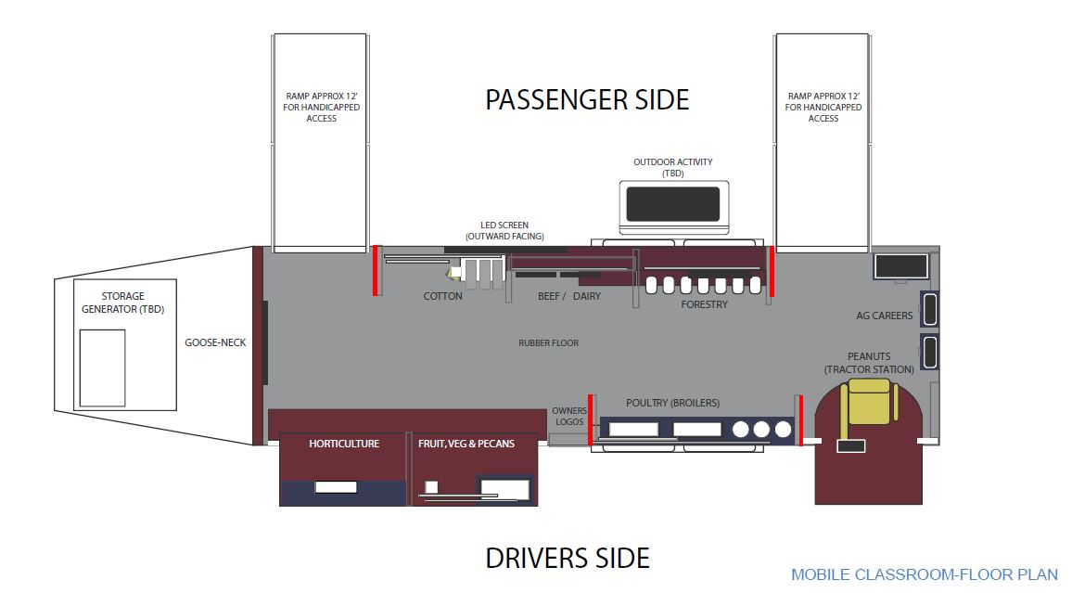
Educational Program Assistant Ag-tivity
Student Ag-tivity with TV Screen - Office Manager or Volunteer
Inside the mobile classroom: Floorplan

Slide 7
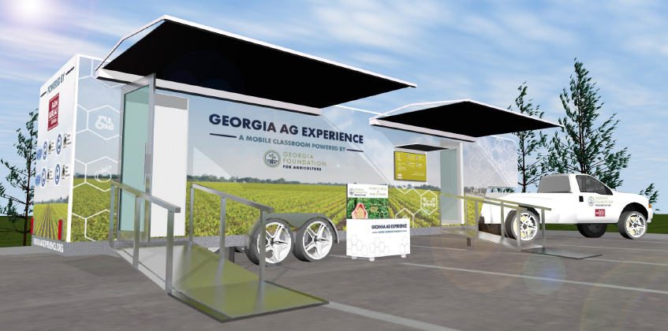
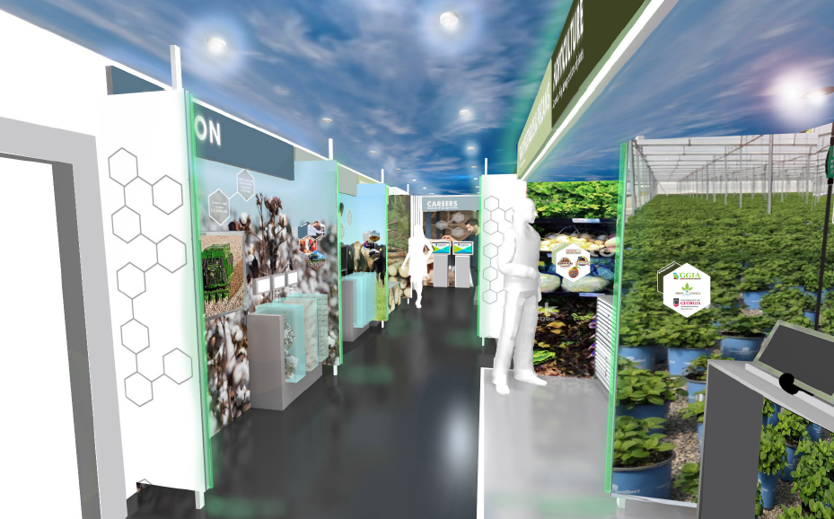
Mobile Classroom Visit:
1 hour experience per student in 2 groups
If class size less than 15...
OUTSIDE
Live “Ag-tivity”
Trailer
Group 1
Group 2
30 mins
30 mins
*allow for social distancing if a large class
Live “Ag-tivity”
INSIDE

Slide 8
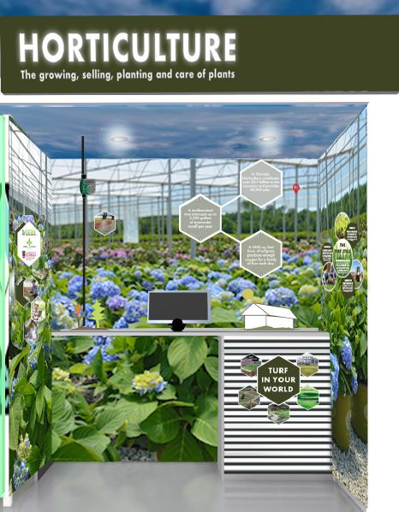
Summary: The diversity of the horticulture industry is shown through interactive augmented reality scenes that tell the journey of a plant from greenhouse, to garden center, to right in your backyard.
Technology Used: Tablet on a slider that moves across three augmented reality animations.
Lessons Learned:
3D growing flower with labeled plant parts to learn the anatomy of a plant.
Right Plant Right Place - Describe your backyard to pick the perfect plant for the right conditions.
  Is the soil wet or dry?
  Is it sunny or shady?
Design your backyard - Build the yard by selecting the right plant from options and planting it in the correct location in your yard.
Sponsors: Georgia Green Industry Association, McCorkle Nurseries, UGA Research Foundation, Urban Ag Council

Slide 9

Summary: Students act as a grocery store clerk and learn how to recognize Georgia grown food products with a UPC scanner learning activity.
Technology Used: UPC Scan Gun and Checkout Video Game.
Lessons Learned: Students learn fun facts about Georgia grown products including: pecans, peaches, blueberries, cucumbers, bell peppers, corn, watermelon and onions.
Sponsors: Agricultural Commodity Commission for Vegetables, ACC for Pecans, Georgia Peach Commission, Georgia Blueberry Commission

Slide 10
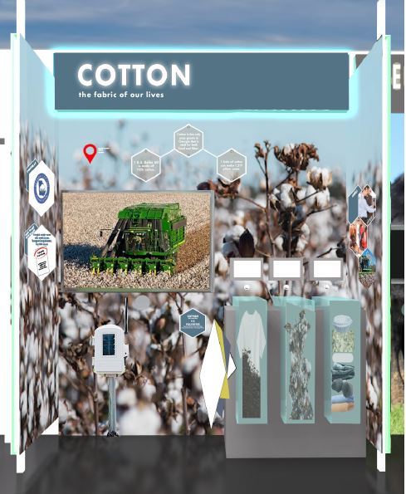
Summary: Students explore the cycles of cotton production with a video spinner that allows the scenes to be played in reverse, sped up, or slowed down. Cotton materials are compared side by side to petroleum-based products.
Technology Used: Video Spinner. Turn a dial to play the video in reverse, fast forward, etc.
Lesson Learned: Cotton vs. polyester, byproducts of cotton, how cotton is grown, harvested and produced.
Sponsors: Georgia Cotton Commission

Slide 11
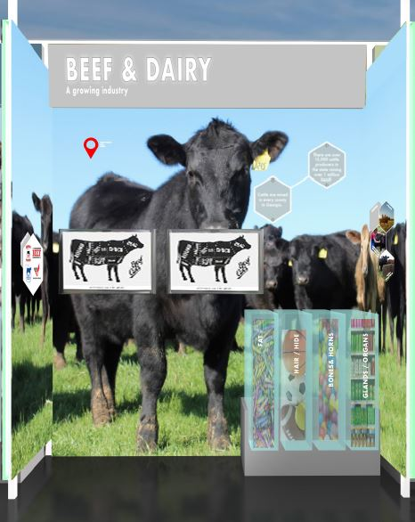
Summary: An animated learning game where students experience the job responsibilities of typical industry careers and get the option of exploring both beef and dairy industries.
Technology Used: Video Game with Touchscreen.
Lessons Learned: Careers in the beef and dairy industry, how an animal is raised, what they are fed, and what they become.
Sponsors: Agricultural Commodity Commission for Beef, Georgia Cattlemen's Association, Georgia Cattlemen’s Foundation, Georgia Beef Board

Slide 12
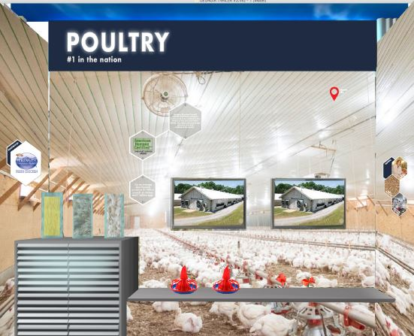
Summary: A comprehensive learning game experience where students engineer a poultry house and must successfully raise hundreds of chickens.
Technology Used: Video Game with Touchscreen.
Lessons Learned: How to engineer a poultry house, how chickens are raised and cared for, and what they are fed.
Sponsors: Fieldale Farms (Springer Mountain)

Slide 13
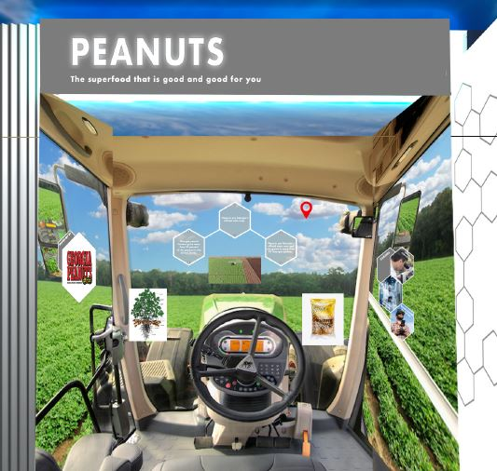
Summary: An augmented reality FENDT tractor simulator that allows students to experience the peanut planting, harvesting, and post-harvest production.
Technology Used: Tablet on a pull cord - when an image is scanned it takes you through three scenes.
Lesson Learned:
Planting season for peanuts & learned the anatomy of a peanut plant. Facts about how much water they need and how long they take to grow.
Harvesting Process - Drone animation shows the tractor “digger” in the soil with the remaining peanut pods, the tractor combine removes the vines from the peanuts.
Finished Product - what happens after the peanuts leave the field? How does the peanut get processed to make peanut butter?
Sponsors: Georgia Peanut Commission & FENDT Tractor/AgCo

Slide 14
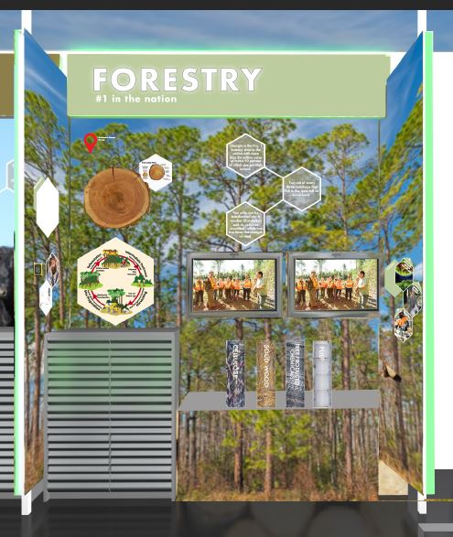
Summary: With a byproducts matching learning activity, students learn the surprising outputs that come from trees.
Technology Used: Touchscreen video game
Lessons Learned: The byproducts of trees

Slide 15

Summary: Student explore the vast opportunities in agriculture by taking a career interest survey. They receive their results with a career badge sticker and watch interactive hologram videos to learn from ag professionals.
Technology Used: Career Interest Survey on touchscreens + hologram of agricultural careers.
Themes: Careers in Agriculture + Large Animal Veterinarians
Sponsors: Georgia Veterinary Medicine Association

Slide 16


Slide 17
COVID-19 PLAN
Guidelines for Educational Program Assistants:
Must wear masks inside trailer at all times!
Must sanitize hands before and after being in the trailer.
County Office Staff/Volunteers:
Help with Sanitation of stations
Help with Students utilizing sanitation stations.
You may choose whether or not you wear a mask unless it is school/organization policy. *
*We will abide by the schools/organizations COVID-19 plans! If they require masks, we will all wear masks.

Slide 18
Cost:
Mobile Visit Fee
County Office
School Budget
4 ways to pay
Local Sponsors
Combination
1
2
$250
3
per day
4
*2 day minimum per school
*subject to change
Notes:
Estimated to cost us around $100 per day

Slide 19
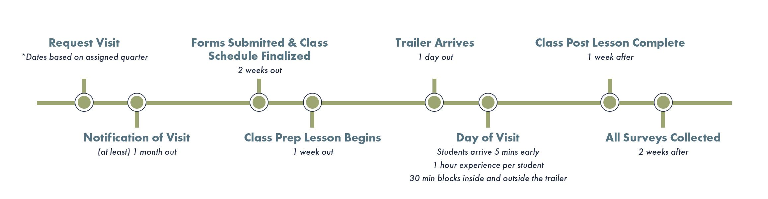
Timeline: From Request to Post Visit
Notes:
This is what every visit will look like..
Visits must be requested by the county office- During sign up period - for each quarter
You will be notified at the end of sign up period, and given next steps
There are some forms that are collected prior.
School prep - lesson plan starts 1 week out
Visit days are likely anywhere from 2-5 day.
After the visit, the school participate in lesson and send in surveys

Slide 20
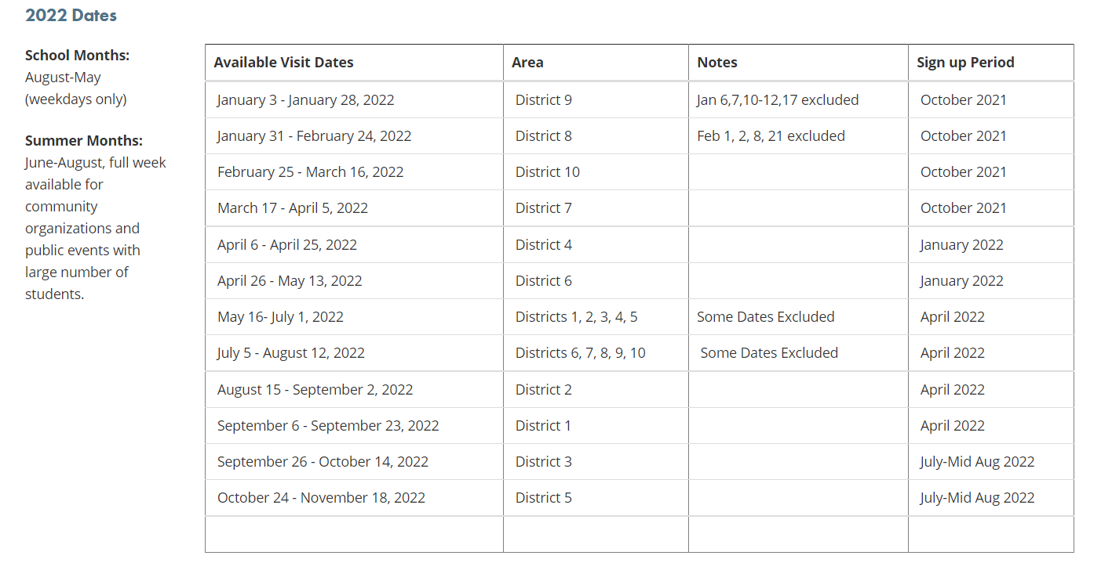
Visit & Sign Up Dates by District

Slide 21



Boots on the ground! Staffing the classroom
Hauler
Main responsibilities: school communication, delivering the vehicle with full generator gas, and managing repairs.
Educational Program Assistant
Main responsibilities: ensuring all station and activities run smoothly, coordinating with organizations.
Main Contact: County Office Manager (preferred) or designated volunteer
Main responsibilities: Requesting the visit, securing 2 volunteers, day-of student safety and sanitation, and promotion of GAE in community.
Support: 1-2 volunteers
Main responsibilities: Day-of student safety and sanitation.
Main Contact: 1 organization appointed volunteer
Main responsibilities: educational program assistant communication, developing classroom schedules, ensuring event is marketed, and communication with hauler for delivery.
Notes:
We all have a part to play in staffing teh mobile classroom

Slide 22
What’s required?
School
Minimum of 150 students for the mobile classroom.
Teachers for each class.
Willingness to complete Pre/Post Lesson Plans.
At least 1 school appointed volunteer to assist with scheduling.
Secure, Level, Paved Parking, away from roadways.
45’L x 30’W space for trailer (Possible 65’L x 30’W for truck and trailer)
Mobile Classroom Provides:
1 Educational Programs Assistant
1-2 Georgia Farm Bureau county volunteers
8 internal stations and external hands-on activity
STEM curriculum developed by UGA
Additional lesson plans for continued engagement.
Sanitation and social distancing plans for COVID-19

Slide 23
Additional Resources for Ag Education
Most importantly, we want agriculture to continue to be a staple in your classrooms.
Check out these ideas on how you can do that!
Reserve a “Traveling Trunk” through our County Farm Bureau office. Georgia Farm Bureau has traveling ag education boxes on forestry and peanuts. These kits provide you all the materials you need to teach a lesson (or two) on either topic.
Visit the Georgia Ag Experience website (www.GeorgiaAgExperience.Org). We have fun activities for kids and additional lesson plans that correspond with each station the students visited in the mobile classroom.
Visit gfb.ag/aitc for AgMags, lesson ideas, ag-tivities, no-bake recipes, book suggestions and much more!
Contact us at the local County Farm Bureau office to learn how we can be a part of your classroom lessons and activities.

Slide 24
Thank you!
We appreciate you allowing us to educate your students about agriculture, and please let me know how we can continue to support agriculture education in your school!

